Slide 1
Reinforcement Learning with Taxi-Traveller Agent
Date 11/04/2020
CS7IS2 Project (2019-2020)
Submitted by:
Ankit Taparia Rocky Bilei Siddhartha Bhattacharyya Srijan Gupta Srijan Gupta

Slide 2
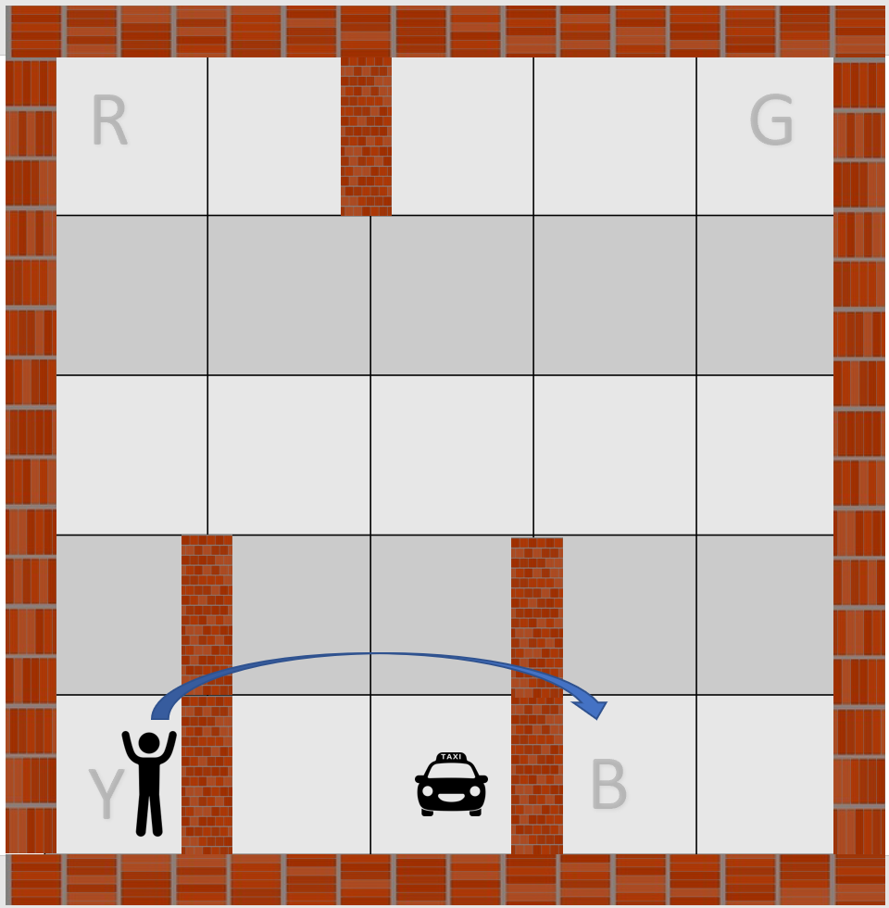
Introduction
Problem Definition
Reinforcement learning algorithms are implemented to design a simulation of a self-driving taxi which involves picking up and dropping of the passenger to the correct location.
The OpenAI Gym environment consists of 500 state spaces and six primitive actions. These actions include four navigations i.e. North, South, East and West and two actions i.e pickup and drop.
There is a reward of -1 for each action and an additional reward of +20 for successfully delivering the passenger. There is a reward of -10 if the taxi attempts to execute the drop or pickup actions illegally.
The taxi problem requires an algorithm that supports temporal abstraction, state abstraction and subtask sharing which makes Reinforcement learning an ideal candidate for solving the task.
Trinity College Dublin, The University of Dublin

Slide 3
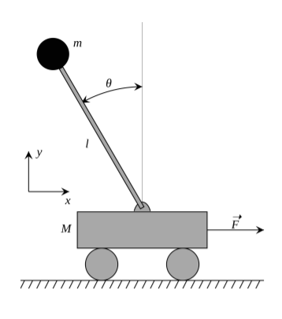
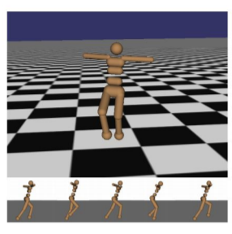
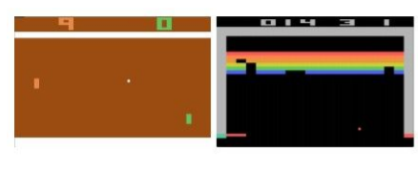
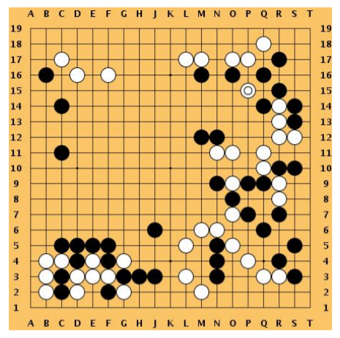
Reinforcement Learning
Area of machine learning concerned with how software agents interact with an environment, which provides numeric reward signals
Goal: Learn how to take actions in order to maximize reward.
Applications
Cart-pole Problem
Robot Locomotion
Atari Games
Go
Trinity College Dublin, The University of Dublin

Slide 4
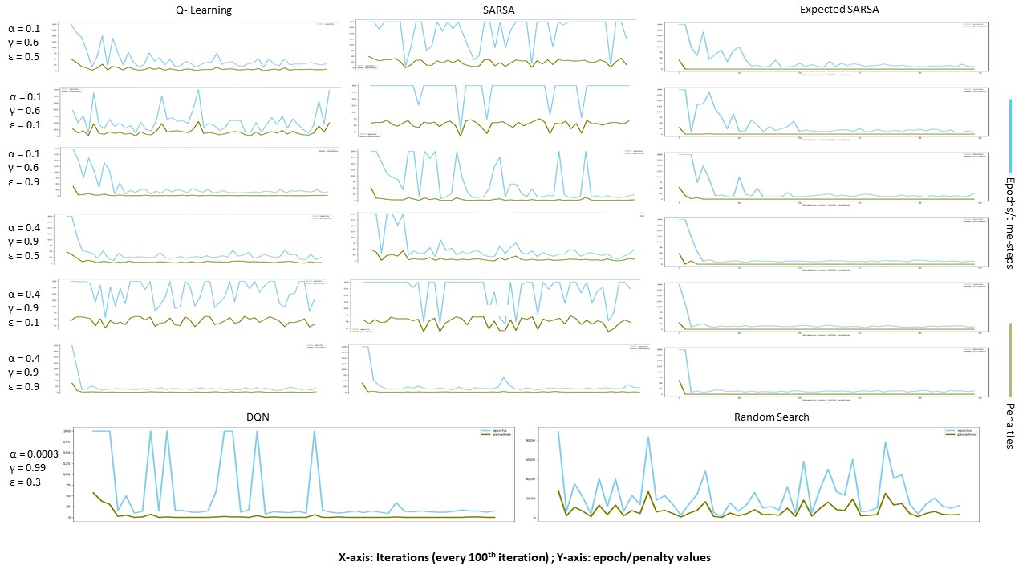
Comparison of Algorithms
Q-Learning, SARSA, Expected-SARSA, Random Search, DQN

Slide 5
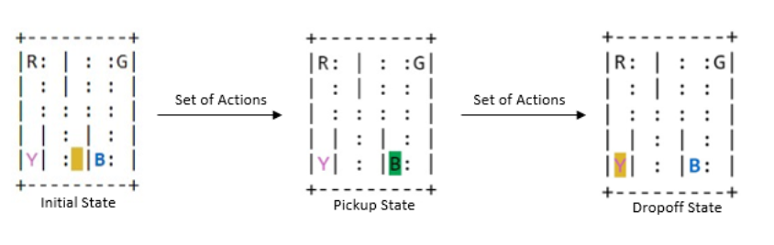
Conclusion
The comparative results show that Expected-Sarsa algorithm worked best giving the least average time steps for the agent to reach its final destination, followed by Q-Learning, DQN and SARSA.
Comparing these state of-the-art algorithms with our baseline Random Search results clearly shows immense improvement.
Better results are achieved using the exploitation approach as compared to the exploration.

Slide 6
Thank You

